Slide 1
384_Detection of Network Attacks on Application Servers Using Deep Learning in IoT Environments
Niranjan W. Meegammana

Slide 2
Outline
Introduction
Research questions and objectives
Literature
Methodology
Results & discussion
Conclusion

Slide 3
Introduction
Application servers using Interconnected IoT devices in critical infrastructure pose security risks.
Current solutions like IDPS have limitations due to IoT constraints.
This research employing ANN DL model, achieved 93% accuracy and 0.99 precision score on network attack detection on IoT servers.
DL can enhance IoT application server security against diverse attacks.

Slide 4
Research questions
What network attacks threaten IoT application servers?
How can DL be used to detect network attacks on IoT servers?
Which DL algorithm best perform in network attack detection

Slide 5
Research objectives
To investigate IoT application server attacks.
To study ML/DL algorithms for attack detection.
To develop a DL model for IoT server attacks.
To evaluate DL model performances

Slide 6
Literature
IoT networks, systems, and data are at risk of cyber attacks.
Current IDS and IPS systems struggle to protect IoT networks.
Deep Learning promises a better solution for attack detection.
The UNSW-NB15 Dataset is more suitable for IoT attack detection.
Many research studies have disregarded data imbalance.
Feature selection is important for constrained IoT Servers.

Slide 7
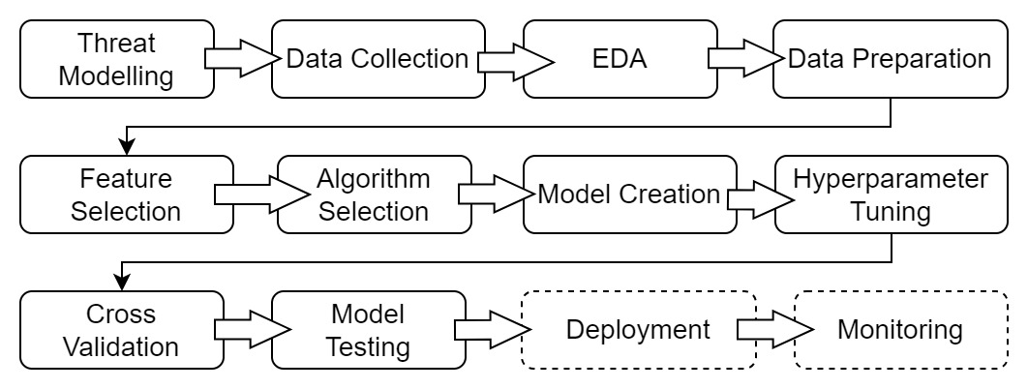
Methodology

Slide 8
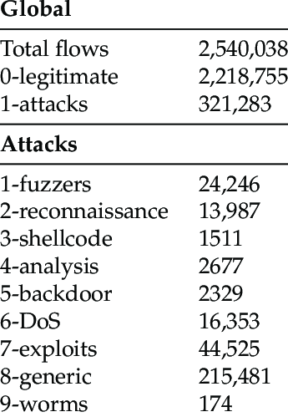
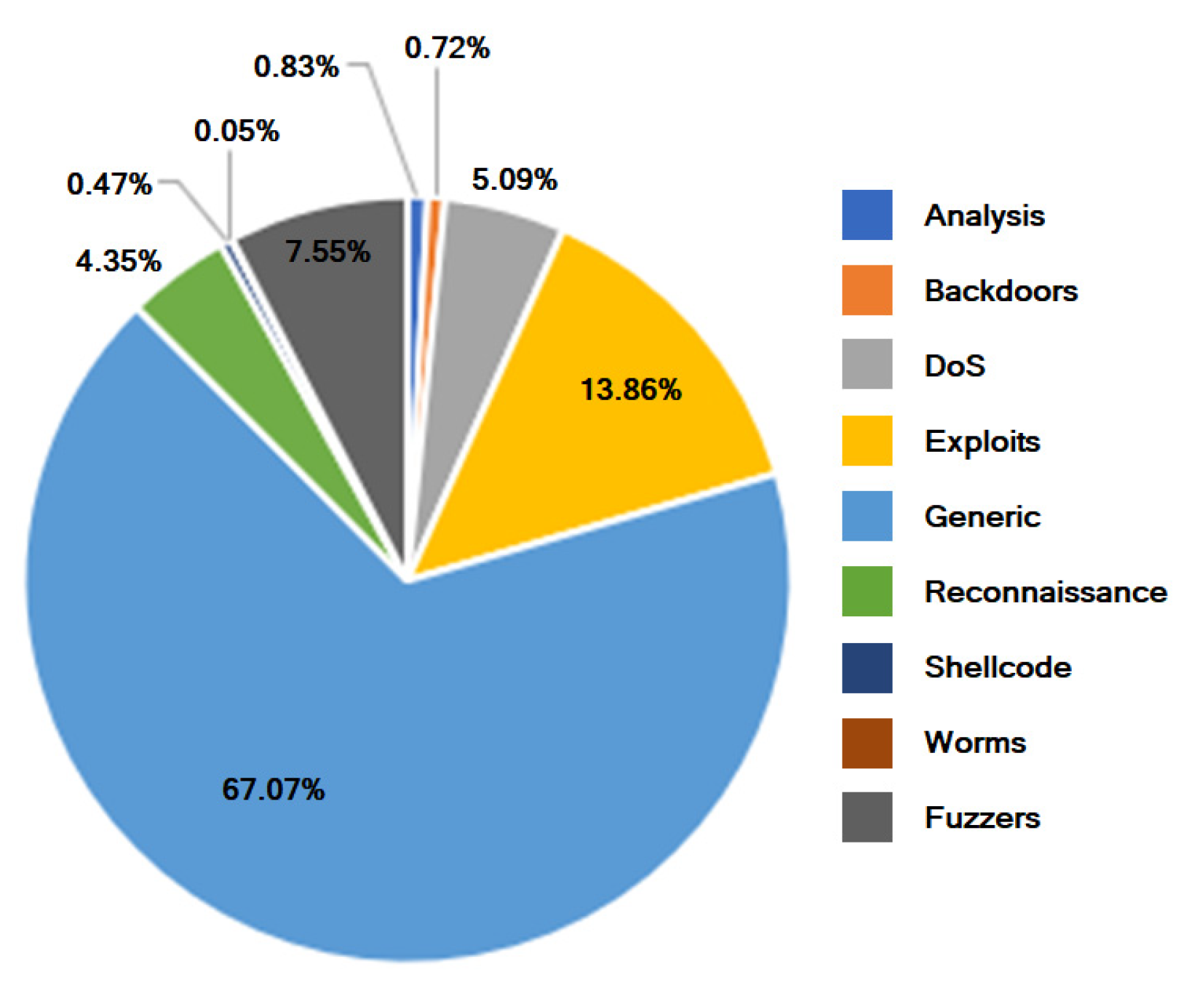
Dataset
Created by UNSW, Australia Contain Hybrid of real modern normal activities a 2.54m samples with 9 attack types having 49 features.

Slide 9
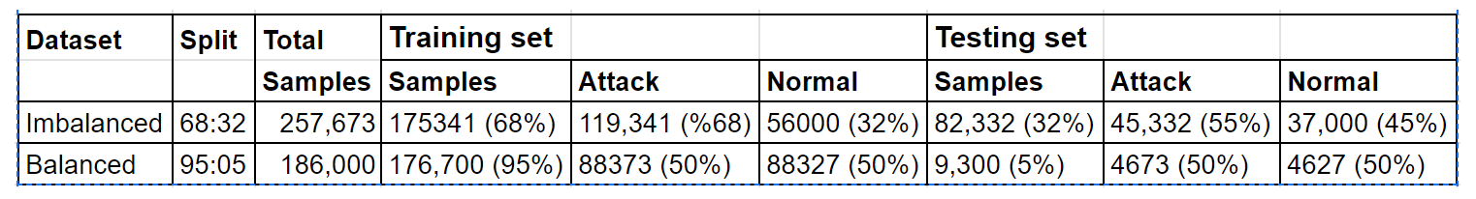
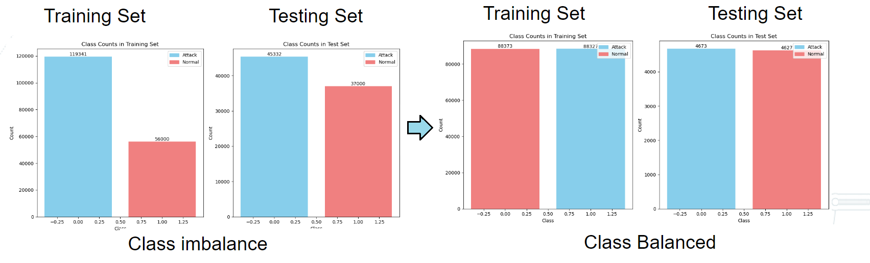
Results & Discussion
Data Preparation : Undersampling of Majoring Class

Slide 10
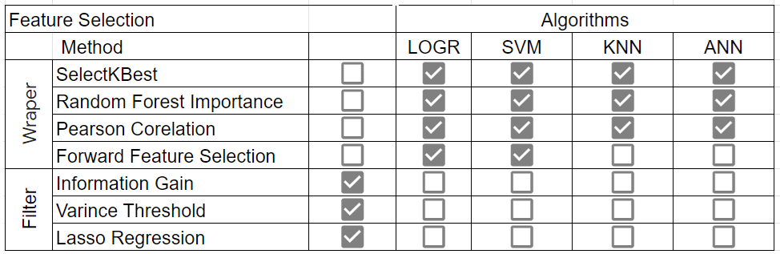
Feature Selection Strategy
Result from all techniques were amalgamated and ranked on feature importance

Slide 11
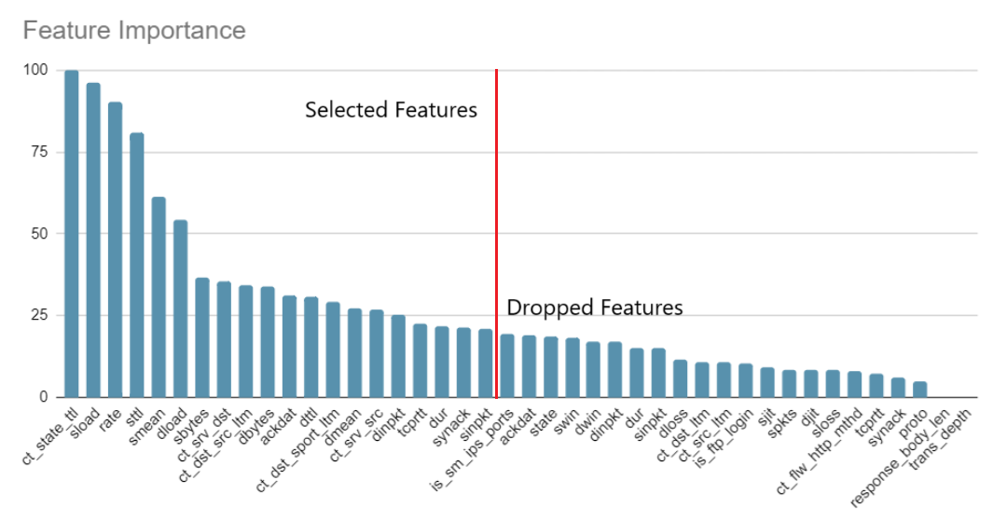
Feature Selection (20 of 42)

Slide 12
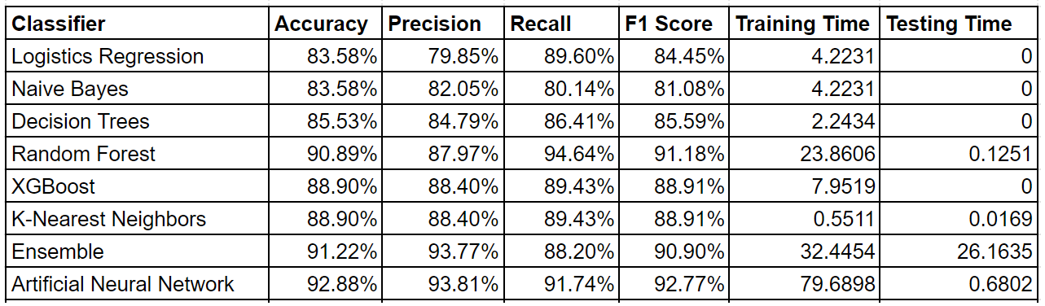
Algorithm Evaluation
Ensemble and ANN surpassed others with ~92% and ~93% classification accuracy. ANN provided faster testing.

Slide 13
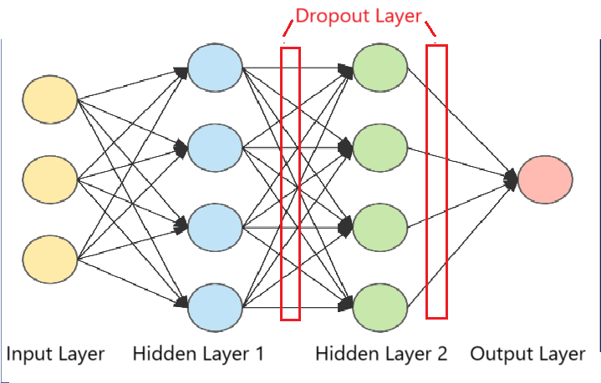
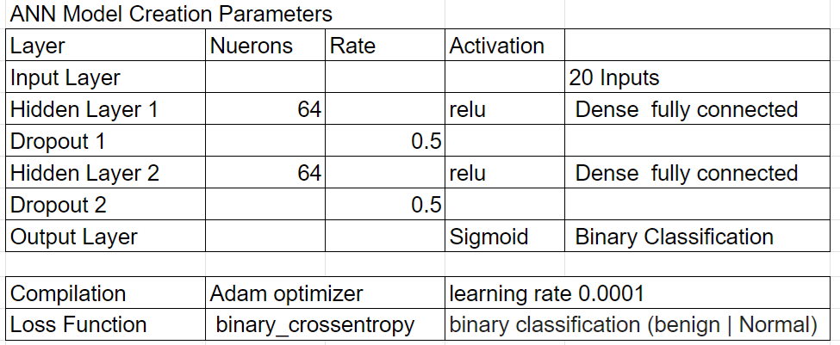
Model Creation
ANN model created using the Keras and Tensorflow libraries

Slide 14
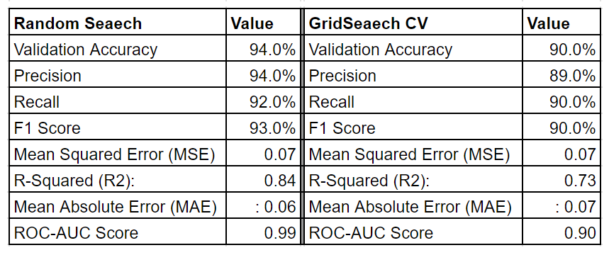
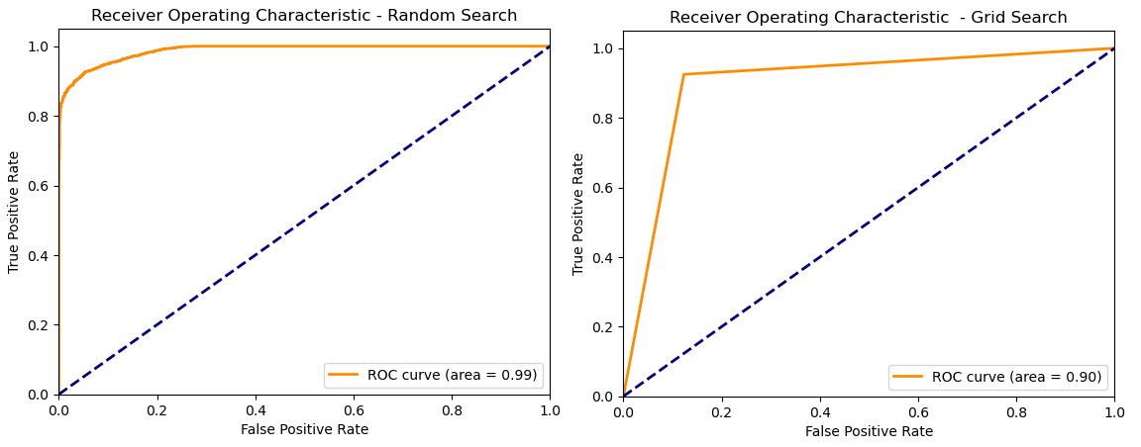
Hyperparameters Tuning
Random Search achieved 0.99 ROC.
A near-perfect curve indicating excellent performance.

Slide 15
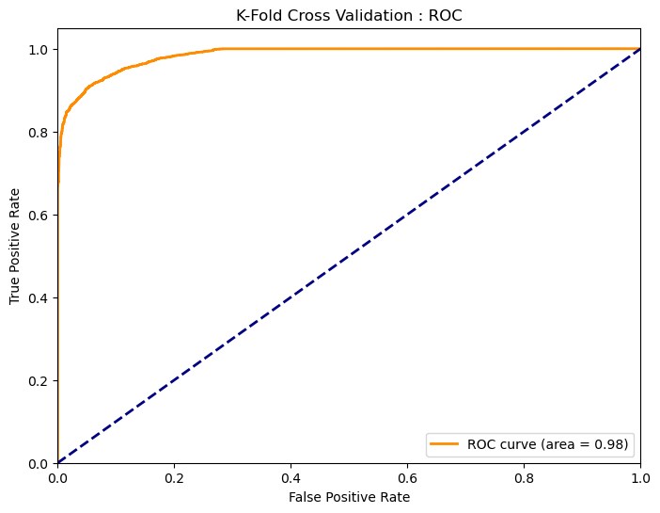
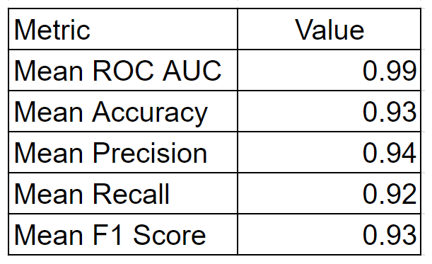
K-Fold Cross Validation
Accounts for data variability
Ensure model reliability and generalization capability
Assurance on low bias and variance.

Slide 16
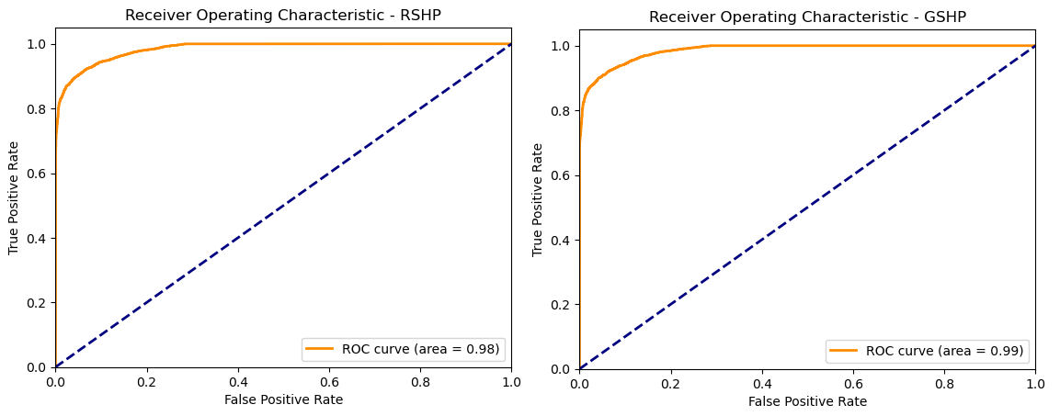
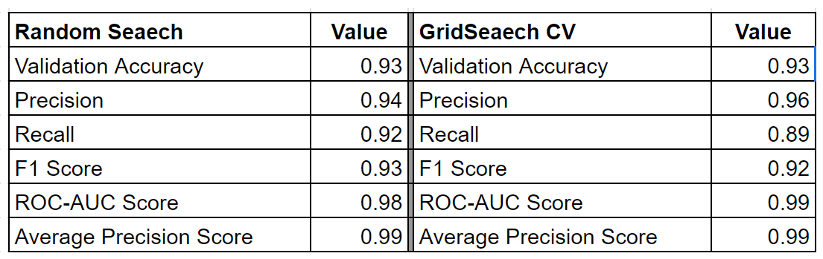
Model Training and Testing
ANN DL model effective in identifying IoT attacks.
It archived superior accuracy, precision, recall, and F1 score.
Excelled in performance and efficiency.
Future research focus on new attack vectors, hyperparameter refinement.

Slide 17
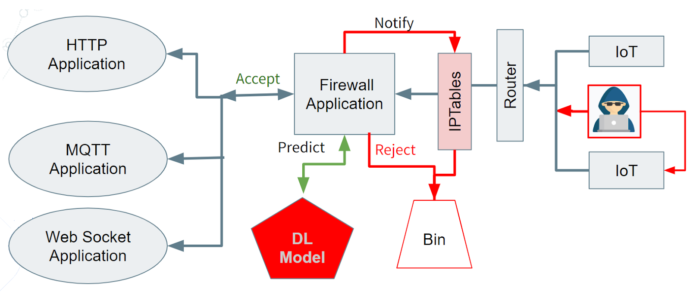
Proposed Implementation

Slide 18
Conclusion
The research enhances IoT application server security in IoT environments using the ANN Deep Learning model, achieving 93% accuracy and a 0.99 Precision Score for detecting attacks. It ensures heightened protection, contributing to a safer digital society.

Slide 19
Acknowledgement
I sincerely thank Dr. Harinda Fernando, my research supervisor,
and Dr. Anuradha Jayakody, the head of graduate studies at SLIIT,
for their guidance, insights, and support throughout this research.

Slide 20
Q & A

Slide 21
ct_state_ttl: Several states that have been filtered.
sload: Source payload rate in bytes per second.
rate: Data transfer rate in bytes per second.
sttl: Time-to-Live (TTL) value configured in the IP header of the packet.
smean: Mean packet size transmitted.
dload: Destination payload rate in bytes per second.
sbytes: The overall volume of bytes transmitted from the source.
ct_srv_dst: Count of connections with the same service.
ct_dst_src_ltm: Count of connections within a specific time window.
dbytes: The aggregate volume of bytes sent from the source.
ackdat: Mean of the diff between ack and seq number for TCP packets.
dttl: TTL value set in the IP header of the packets received.
ct_dst_sport_ltm: Count of connections between same dest and source port pair in a time window.
dmean: Mean packet size received by the destination in a network flow.
ct_srv_src: Number of connections with the same service on the source side.
dpkt: Total number of bytes received by the destination IP address.
tcp rtt: The mean round-trip time for TCP connections.
dur: Duration of the network flow or connection in seconds.
synack: Average time duration between the SYN and ACK packets in a TCP connection setup.
spkt: Mean time between two consecutive packets sent from the source.

